Slide 1

Angular js
Forms
Author : Gauthier PEEL

Slide 2
AngularJS
PluralSight AngularJS PlayBook :
by Scott Allen
chapter 5 : FORMS
=> ng-messages , custom error messages directive, custom validation directive, custom async validation directive
PLuralSight : Angular Fundamentals
by Joe Eames and Jim Cooper
ch2-last-video
simple validation : ngPattern, required, ngDisabled, $valid, $untouched

Slide 3
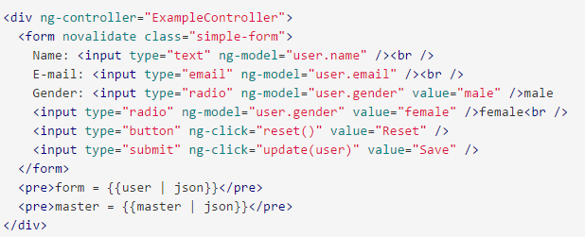
AngularJS
FORM
ng-model is the 2 way data binding Angular is so famous about !
novalidate (attributes defined in HTML 5) => disables the browser automatic validation
Check the HTML5 types : text, email, number …
type="mail" prevents an invalid value to be synced with the binding data defined in ng-model user.mail if not valid
Notes:
on the plunk
We see how to use the ng-valid ng-invalid ng-touched etc class that NG sets on the fields

Slide 4
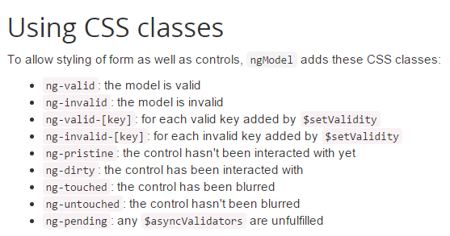
AngularJS
On user inputs, Angular adds and removes classes from HTML elements
On the <form> element you have one more property :

Slide 5
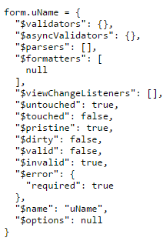
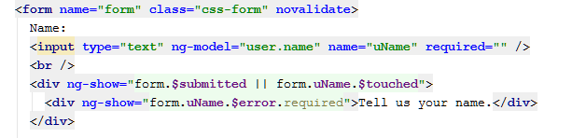

AngularJS
In our example, 'form' is an instance of FormController a specifc Angular js object, which has been made accessible by giving it a name on the current $scope
An ngModel directive holds an instance of NgModelController, and could also be named.
Beware in HTML5 : required = "" is a good syntax
As well as required alone is enough, but required="false" is an antipattern

Slide 6
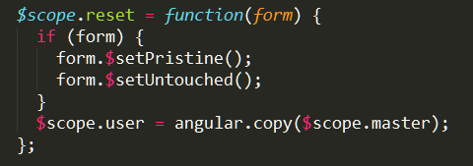
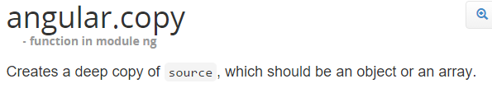
AngularJS
Accessing form/input properties by JS code
Those attributes could be set in JS code :

Slide 7
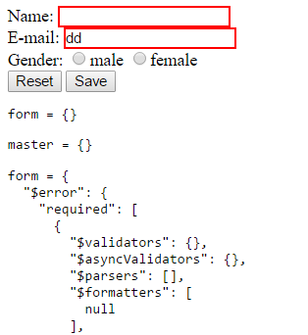

AngularJS
Form/Input state impact on CSS
Angular applies CSS styles automatically according to state
To get impact on the page, we just have to define the content of those CSS

Slide 8


AngularJS
How to show a message
Factorize 'form.uEmail.$error' definition with ng-message :

Slide 9

AngularJS
Showing message : ng-show ok but ….
CSS is better !
exercise !

Slide 10
ngMessages
Setup : ngMessages should be added to modules deps : And also as an added script :
Showing error message : ng-message
By default, ng-message shows only one message at a time and this depending on the priority of the messages within the template. Change this behavior by adding the ng-messages-multiple or multiple attribute on the directive container.
For a specific field : ng-messages="<formName>.<fieldname>.$error
For the entire form errors : ng-messages="<formName>.$error

Slide 11
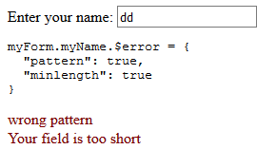
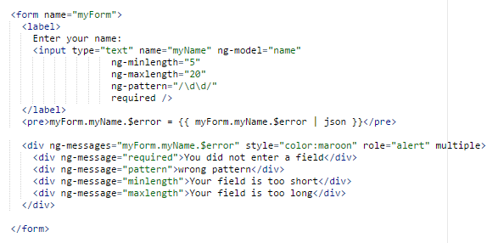
Example
(modified) angular doc plunk example from :
https://docs.angularjs.org/api/ngMessages/directive/ngMessages

Slide 12
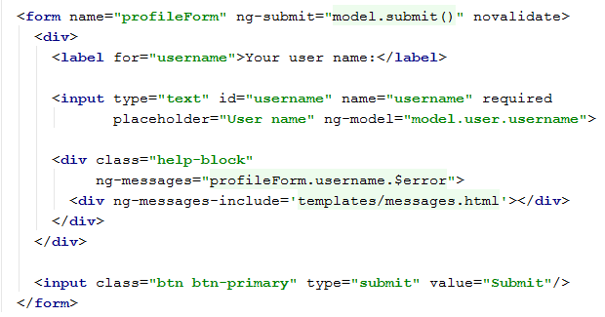

AngularJS
BETTER factorisation : ng-messages extracting messages in a file
the file templates/message.html

Slide 13
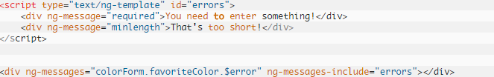
AngularJS
ng-messages extracting messages in a file
the message template file could even be defined inline :

Slide 14
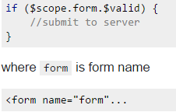
AngularJS
Preventing submit when the form is NOT valid
JS
HTML

Slide 15
AngularJS
Adding Validation
HTML5 validation attributes are :
Technical : required, min, max, maxlength, pattern (regexp)
Functional : email, url, number, tel, date, range
Adding novalidate to the form to prevent the browser from showing its own error messages :
http://www.the-art-of-web.com/html/html5-form-validation/
https://developer.mozilla.org/en-US/docs/Web/JavaScript/Reference/Global_Objects/RegExp

Slide 16

Bootstrap styles
Forms styles

Slide 17
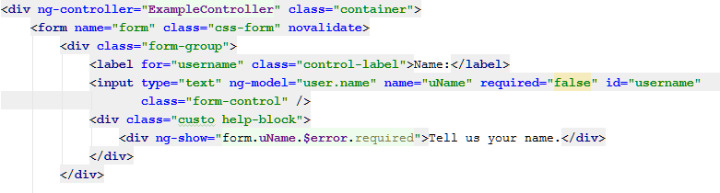
Bootstrap
Adding styles to your FORMS !
Add bootstrap.css to your page
Style | Target
class="form-group" | <div > around an input
class="form-control" | <input > except radio and checkbox
class="control-label" | <label>
class="help-block" | <div ng-messages="" ..>

Slide 18
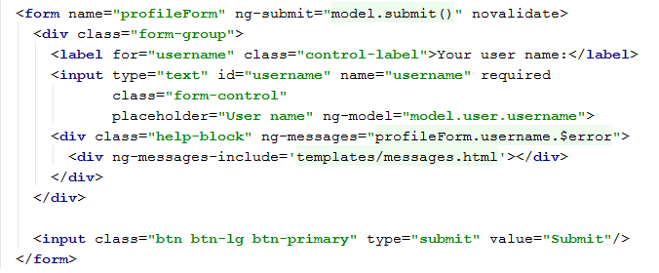
AngularJS
Example
the file templates/message.html

Slide 19
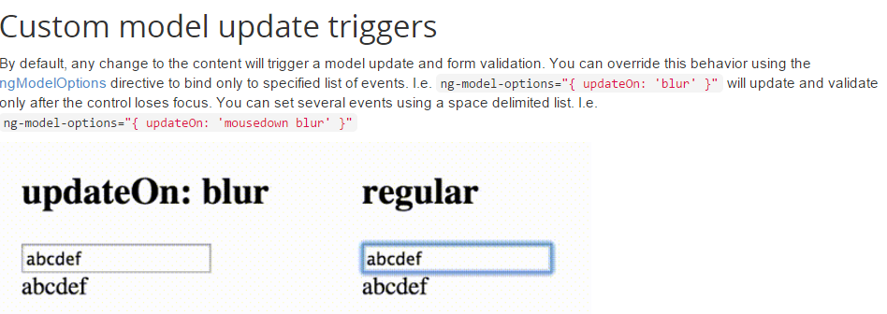
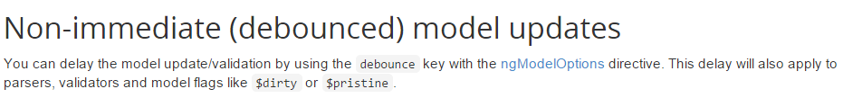
AngularJS
FORM Update events

Slide 20
AngularJS
ng-show vs ng-if
ng-if will remove elements from DOM.
ng-show/ng-hide does not remove the elements from DOM. It uses CSS styles to hide/show elements
ng-if creates a child scope while ng-show/ng-hide does not
For performance : ng-if should be preferred

Slide 21
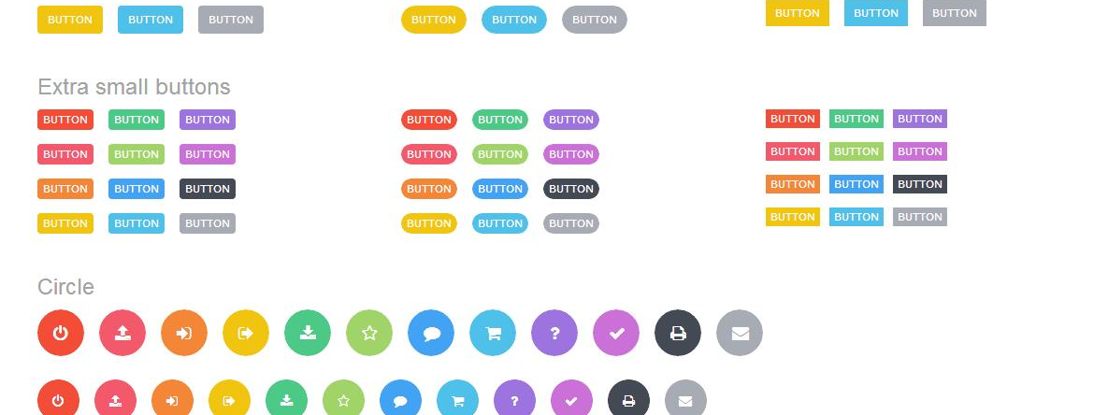
Combo

Slide 22
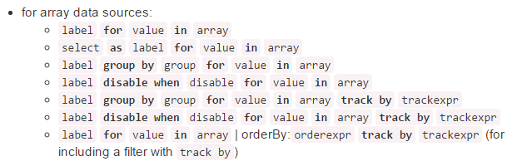
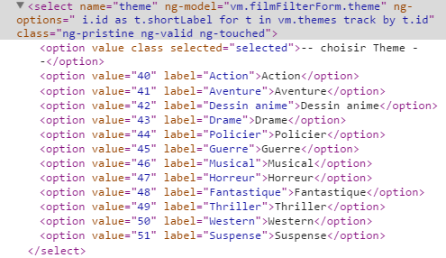
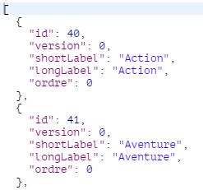
AngularJS
themes array

Slide 23
AngularJS
Should be understood :
'label' means the text shown to the user in the combo, and the code should give a value instead of the placeholder 'label' in the spec :
person.name for person in vm.personArray
'value' means the name of a variable loop value of an item from the array : person
select' means the value returns when submitted : person, or person.id value could either be the FK (id) or the full object
Even if the full sentence is strange, we just have to replace 'label' 'value' and 'select' by code.
In short the words "select' 'value' and 'select' should NOT appear in the options parameter

Slide 24

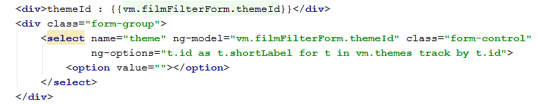
AngularJS
Combo usual problem : selected item when going back with different data
You choose your theme

Slide 25

AngularJS
Combo usual problem : selected item when going back with different data
Suppose you keep the form 'filmFilterForm' here) value somewhere,
leave the page and
come back to the page
You combo does not come back with anything selected ? strange ?
The reason is that Angular compares the objects with '===' and the objects are NOT strictly equal.
The second possible reason is that angular cannot track item by anything else than object
http://stackoverflow.com/questions/31163114/angular-ng-options-track-by-issue
Notes:
<div>themeId : {{vm.filmFilterForm.themeId}}</div> <div class="form-group"> <select name="theme" ng-model="vm.filmFilterForm.themeId" class="form-control" ng-options="t.id as t.shortLabel for t in vm.themes track by t.id"> <option value=""></option> </select> </div>
REASON :
http://gurustop.net/blog/2014/01/28/common-problems-and-solutions-when-using-select-elements-with-angular-js-ng-options-initial-selection/
The track by syntax expects an object, with the property you use to track. It does
not honor the key part used in the key as text syntax (which in our example is
g.id as g.text ), so, it wants the ng‐model to point to an object with the tracked
Root Cause
Solution
Simple Properties Scenario When Combined With Server-Side
Submit
Root Cause
12345
<select
ngmodel="
person.genderId"
ngoptions="
gender.id as gender.text for gender in genders">
</select>
7/9/2015 How to set the initial selected value of a select element using Angular.JS ngoptions
& track by / (AngularJS & ASP.NET MVC) Gurustop.NET By @...
http://gurustop.net/blog/2014/01/28/commonproblemsandsolutionswhenusingselectelementswithangularjsngoptionsinitialselection/
4/18
property, it cannot be the key itself directly.

Slide 26
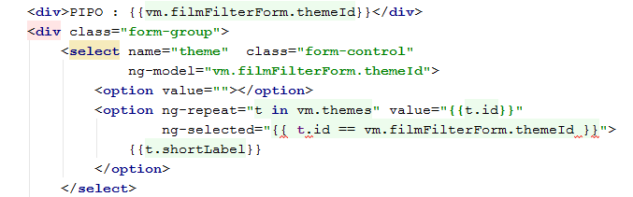
AngularJS
Combo usual problem : selected item when going back with different data
Solutions : sometimes it works !
Solution 1 : develop your own ng-repeat 'by-hand' explicitly
Notes:
<div>PIPO : {{vm.filmFilterForm.themeId}}</div> <div class="form-group"> <select name="theme" class="form-control" ng-model="vm.filmFilterForm.themeId"> <option value=""></option> <option ng-repeat="t in vm.themes" value="{{t.id}}" ng-selected="{{ t.id == vm.filmFilterForm.themeId }}"> {{t.shortLabel}} </option> </select> </div>

Slide 27
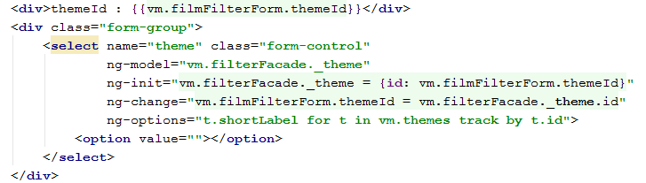
AngularJS
Combo usual problem : selected item when going back with different data
Solutions : sometimes it works !
Solution 2 : more complicated but educational
Notes:
<div>themeId : {{vm.filmFilterForm.themeId}}</div> <div class="form-group"> <select name="theme" class="form-control" ng-model="vm.filterFacade._theme" ng-init="vm.filterFacade._theme = {id: vm.filmFilterForm.themeId}" ng-change="vm.filmFilterForm.themeId = vm.filterFacade._theme.id" ng-options="t.shortLabel for t in vm.themes track by t.id"> <option value=""></option> </select> </div>

